Slide 1
Fundamentals of Strings
Strings in C are nothing but characters in an array with a null terminator character to mark the end of the string.
How did we define array of integers? array of float ? array of short ? Similarly , when you define array of characters, it is considered a string. But you have append the null character at the end.

Slide 2
Introduction to String data type
int data [ 30 ] ; // data is an array and pointer constant
short data [ 30 ] ;
float data [ 30 ] ;
when it comes strings, we define
char name[30] ; // string, name is a string array
strings should contain a null terminator '\0' to mark the end of the string ( more soon)

Slide 3
Fundamentals of Strings and Characters (Cont.)
A string is a series of characters treated as a single unit.
A string may include letters, digits and various special characters such as +, -, *, / and $.
String literals, or string constants, in C are written in double quotation marks.

Slide 4
Fundamentals of Strings and Characters (Cont.)
A string in C is an array of characters ending in the null character ('\0').
A string is accessed via a pointer to the first character in the string.
Thus, in C, a string is a pointer; a pointer to the string’s first character.
In this sense, strings are like arrays, because an array is also a pointer to its first element.
A character array or a variable of type char * can be initialized with a string in a definition.
when you calculate the length of the string, the null terminator is not counted. We will come to this soon

Slide 5
Declare and initialize strings
There are many methods we could declare and initialize a string array. we will list 6 of them here
Method 1 – assign a character in each cell
Method 2 – Assign a string constant
Method 3 – using scanf function, %s specifier
Method 4 – using (string lib) strcpy function
Method 5 – initialize during declaration , like in Method 1
Method 6 – using a string constant to a pointer

Slide 6
Fundamentals of Strings and Characters (Cont.)
Method 1
char data [ 6 ] ; // define an array
data[0] = 'H' ; // letter
data[1] = 'E' ;
data[2]= 'l' ;
data[3]= 'l' ;
data[4]= 'o' ;
data[5] = '\0' ; // null terminator
we assigned each cell a character. Then, we assigned the null terminator to mark the end.

Slide 7

Fundamentals of Strings and Characters (Cont.)
char data[] = "Hello"; // Method 2
In this method, the program declares a string constant "Hello in it's local memory, and then copies the string to the data array.
It copies even the (hidden) null terminator to data.
Now data contains
the length of the string is 5, length of the array is 6.

Slide 9

Fundamentals of Strings and Characters (Cont.)
char data[10];
scanf ("%s", data); // Method 3
When you enter an input "Hello", scanf will read the string and copies into the data array. We have to make sure data is big enough to hold the data user entered plus the null terminator.
Variable data is an array, which is, of course, a pointer, so the & is not needed with argument da.
data is now
length of the string is 5, length of the array is still 10.

Slide 10
Fundamentals of Strings and Characters (Cont.)
strcpy ( data, "Hello" ); // Method 4
strcpy is a library function. it will copy the "Hello" into the data array. Again, we have to make sure data is big enough to hold all characters plus a null terminator.
strcpy can also copy from one array to another array
char data2[10 ] = "World"
strcpy ( data2, data ); // copies data to data2 array

Slide 11
Fundamentals of Strings and Characters (Cont.)
char data[] = {'H', 'e', 'l', 'l', 'o', '\0'}; // Method 5
Much similar to Method-1 and array initialization, here we initialize the string array with each character, including the null terminator. The length of the array now is: 6, but the string length is 5.
This definition automatically determines the size of the array based on the number of initializers in the initializer list.

Slide 12
Fundamentals of Strings and Characters (Cont.)
char *ptr = "Hello"; // Method 6
Here the program will store "Hello" in it's local memory, if not already there. The address of this local memory is then assigned to the pointer ptr.
"Hello" is a constant string, trying to change the string will result in run time error, like try to assign *ptr = 'h' will result in error.

Slide 13
TIPS TO HANDLE STRING
Make sure the string array has sufficient space to hold a string + a null terminator
Make sure the string array has a null terminator at the end of the string
You cannot change the string literals aka string constant such as within quotes "Hello"
Because string array is also a pointer, the & in front of the array is not needed when passing the string to functions
Null terminator is not counted for the length of the string.

Slide 14
Revisit Scanf function
A string can be stored in an array using scanf.
For example, the following statement stores a string in character array word[10]:
scanf("%s", word);
The string entered by the user is stored in word.
Variable word is an array, which is, of course, a pointer, so the & is not needed with argument word.

Slide 15
Revisit Scanf
scanf will read characters until a space, tab, newline or end-of-file indicator is encountered.
So, it’s possible that, without the field width 10 in the conversion specifier %10s, the user input could exceed 10 characters and that your program might crash!
For this reason, you should always use a field width when using scanf to read into a char array.
The field width 10 in the preceding statement ensures that scanf reads a maximum of 10 characters and saves the last character for the string’s terminating null character.

Slide 16
Fundamentals of Strings and Characters (Cont.)
This prevents scanf from writing characters into memory beyond the end of s.
(For reading input lines of arbitrary length, there’s a nonstandard—yet widely supported—function readline, usually included in stdio.h.)
For a character array to be printed properly as a string, the array must contain a terminating null character.

Slide 17
Integer array vs String Array
when we pass arrays (of any datatype except string) to functions, we also pass the number of cells in the array.
String have null terminator. Because of that, we don't pass the number of cells in the array to string library functions. The function will search for the null terminator.
Because array data can be accessed via pointers, all the string library functions receive pointer as one of the parameter, though the string is stored in a array.

Slide 18
string library functions
strlen - calculate the length of a string
strcpy – copies a string from one to another
strcmp – compares two strings for equality
strcat – appends one string to another string
a
strstr – checks for the presence of a substring in a string
strchr - locate character in string
strrchr - locate last character in string
In the examples that follow, assume
char data1[ 10 ] = "Hello";
char data2[10 ;

Slide 19
additional string functions that take number of characters to process
strnlen – determine the length of a fixed-size string
strncpy – copies n characters
strncat – copies n characters
strncmp – compares only n characers
strnchr – check for a character within n character
strnstr – checks for a substring within n character.
please see man pages

Slide 20
string functions-strlen
size_t strlen (const char *s)
calculates the length of the string pointed to by s, excluding the terminating null byte ('\0').
returns the number of character in the string pointed to by s upto the null character.
we implement several versions of this function in next couple of slides

Slide 21
Implementation of strlen function
char data1[10] = "Hello" ;
int i = 0 , len=0;
while ( data1[i++] != '\0' )
len++;
printf ( " length=%d\n", len);

Slide 22
Implementation of strlen function
char *ptr = "Hello" ;
int i = 0 , len=0;
while ( 1 ) {
if ( *ptr == '\0' )
break;
else
len++, ptr++;
}
printf ( "length=%d\n", len);
return 0;

Slide 23
Alternate Implementation of strlen function
char data1[10] = "Hello" ;
int i = 0 , len=0;
for ( i = 0 ; data1 [i] != '\0' ; i++, len++)
;
printf ( "length=%d\n", len) ;

Slide 24
Alternate Implementation of strlen function
char *ptr = "Hello" ;
int len=0 ;
for ( ; *ptr != '\0' ; ptr++, len++) ;
printf ( "length=%d\n", len);

Slide 25
Alternate Implementation of strlen function
char *ptr = "Hello" , *ptr2 = ptr ;
for ( ; *ptr != '\0' ; ptr++) ;
printf ( " length=%d\n", (int)(ptr-ptr2) ) ;

Slide 26
string copy function: strcpy
char * strcpy(char *restrict dest, const char *src);
The strcpy() function copies the string pointed to by src, including the terminating null byte ('\0'), to the array pointed to by dest. The strings may not overlp, and the destination string dest must be large enough to receive the copy. Beware of buffer overruns!
If the destination string of a strcpy() is not large enough, then anything might happen

Slide 27
strcpy examples
char str1[16] ; // str1 is an array and pointer constant
char str2[16] = "David" ; // OK during initialization
strcpy (str1, str2) ; // copies str2 to str1 array including '\0'
strcpy (str1, "Utah") ; // OK, copies "Utah" including '\0'
char *ptr = "Hello" // make ptr point to Hello
strcpy ( str1, ptr) ; // copies "Hello" to str1 array including '\0'
ptr = str1; // pointer points to str1 array
strcpy ( ptr, "World"); // copies "World" to str1
str1 = "Utah" ; //wrong, you cannot assign values to array
str1 = str2 ; // wrong, str1 is an array, you cannot assign

Slide 28
string compare function - strcmp
int strcmp(const char *s1, const char *s2);
strcmp ( "hello", "HELLO")
The strcmp() function compares the two strings s1 and s2.
strcmp() returns an integer indicating the result of the comparison, as follows:
0, if the s1 and s2 are equal;
a negative value if s1 is less than s2;
a positive value if s1 is greater than s2.

Slide 29
strcmp examples
int x = strcmp ( "Hello", "Hello") returns 0 because they are same
int x = strcmp ( "Hello ", "hello") returns < 0
int x = strcmp ( "hello", "Hello") returns > 0
char data[10] ;
strcpy ( data, "Hello");
strcmp ( data, "Hello"); will return 0

Slide 30
string function - strcat
char *strcat(char *restrict dest, const char *restrict src);
The strcat() function appends the src string to the dest string, overwriting the terminating null byte ('\0') at the end of dest, and then adds a terminating null byte. The strings may not overlap, and the dest string must have enough space for the result. If dest is not large enough, program behavior is unpredictable;
char data1[10] = "Hell",
data2[10] = "o" ;
strcat ( data1, data2) ;
printf("%s\n ", data1); // will print Hello

Slide 31
string function - strchr
char *strchr(const char *s, int c);
The strchr() function returns a pointer to the first occurrence of the character c in the string s. The function return a pointer to the matched character or NULL if the character is not found. The terminating null byte is considered part of the string, so that if c is specified as '\0', strchr function return a pointer to the terminator.
char data1[10] = "Good Job" ;
char *ptr = strchr ( data1, 'J') ;
printf("%s\n ", ptr); // would print Job

Slide 32
string function - strstr
char *strstr(const char *haystack, const char *needle);
The strstr() function finds the first occurrence of the substring needle in the string haystack. The terminating null bytes ('\0') are not compared.
The function returns a pointer to the beginning of the located substring, or NULL if the substring is not found.
char data1[10] = "Good Day" ;
char data2[ ]= "Day" ;
char *ptr = strstr ( data1, data2) ;
printf("%s\n ", ptr); // would print Day

Slide 33
simple programs, print characters
char names[16] = "California" ;
int i = 0;
while ( names [ i ] != '\0' )
{
putchar ( names [ i ] ) ) ;
i++ ;
}

Slide 34
simple programs , printing characters line by line
char names[16] = "California" ;
int i = 0;
while ( names [ i ] != '\0' )
{
printf( " %c\n", names [ i ] ) ;
i++ ;
}

Slide 35
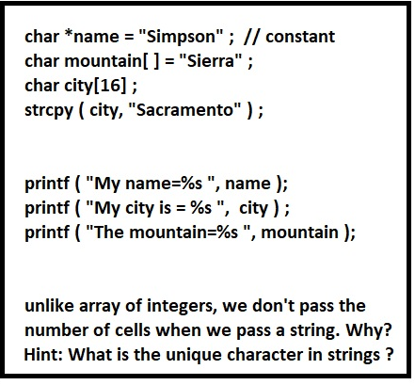
Passing String to a (printf) function

Slide 36
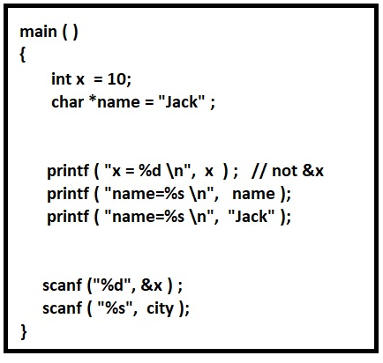

Slide 37
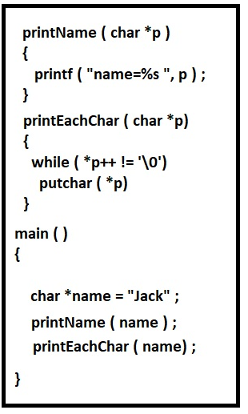

Slide 38
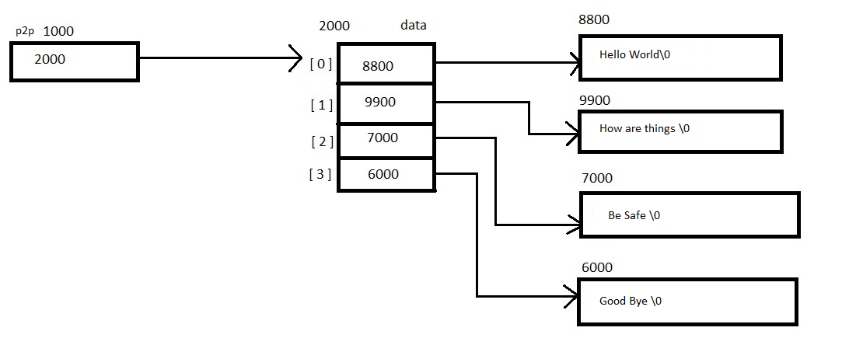

Slide 39
#include <stdio.h>
char *data [ ] = { "Hello World", "How are things", "Be Safe", "Good Bye"};
int main() {
char **p2p ;
p2p = data ;
printf ( "first string using data array %s\n", data[0]);
printf ( "second string using data array %s\n", data[1]);
printf ( "third string using data array %s\n", data[2]);
printf ( "fourth string using data array %s\n", data[3]);
printf ( "\n");
printf ( "first string using *p2p = %s\n", *p2p++);
printf ( "second string using *p2p = %s\n", *p2p++);
printf ( "third string using *p2p = %s\n", *p2p++);
printf ( "fourth string using *p2p = %s\n", *p2p++);
return 0;
}

